Slide 1
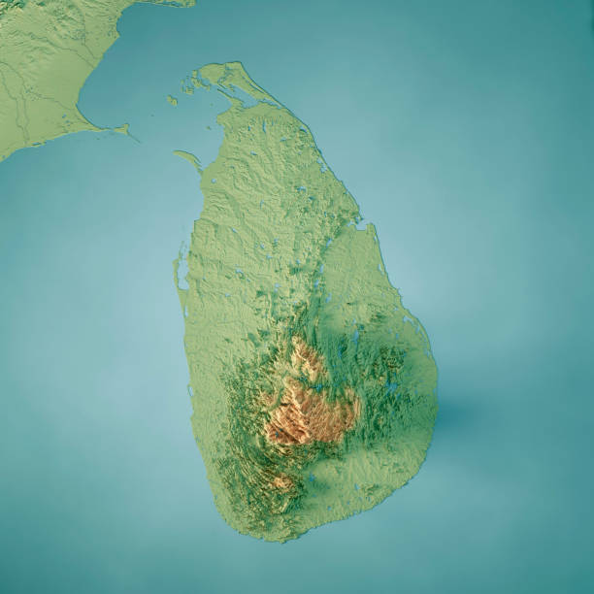
Maritime Intervention OP Pawan
Lessons to be Learned
Vice Admiral (Retd.) Vijay Shankar
Notes:
957 days (29 jul 87-24 Mar 1990); 1274 casualties; 3000 wounded; Peace keeping that morphed to peace enforcement; SLN dedicated a memorial close to Parliament. Ideological indoc a must to create and build a nation. State structure of the day NOT due peaceful teleological growth.

Slide 2
Strategic Perspectives 1987
Dying Throes of the Cold War
Fragmenting States:
Intense Motivation
SL Since Sinhala Bill of 1956
India Post BrassTacks &
Chequer Board “Strat Hubris”
Rise of China
Extra regional presence
Vice Admiral (Retd.) Vijay Shankar
Notes:
State of Tamils. Business & Fin sectors Liquidated assets. China open door toKissingers West. Uss Belknap, Perry.

Slide 3
The Civil War in Sri Lanka
1983 Black July Anti Tamil Pogrom
Trg Tamil Militants (83-87)
Siege of Jaffna
Op Poomalai
Prep for intervention Op Sting
Vice Admiral (Retd.) Vijay Shankar
Notes:
The Mahavamsa ref. India casts the die as to which side they were on. Poomalai classic iron fist in a velvet glove. Intervention on who’s side?

Slide 4
Indo-Sri Lanka Accord 29 Jul 87
Lift siege Jaffna & Disengage
IPKF Deploy; LTTE Disarm
North & East Prov Merge
Enhance Autonomy of Prov
Recognise Equality for All
Referendum & Dev of Power
Vice Admiral (Retd.) Vijay Shankar

Slide 5
Nature of Operations
Mismatch intensity of
Interests: Survival vs Major(scale of 4)
Defeat & Occupation only way to
break Will
Imbalance: Clausewitz Trinity IPKF-Purpose/Obj/Means Ltd LTTE-UnLtd
PeaceKeeping Morphed to Enforcement
Vice Admiral (Retd.) Vijay Shankar
Notes:
Interests: Survival, Vital Major, Peripheral.

Slide 6
Dynamics of C2 & Coord
Instant Appraisal More about Judge than Situ Judged
Wavering Strat Plans, Mazy Chain of Cd=Confused DM
Inability to Understand Situ demanded Policy-Strat-Op Meld
Absence of real-time Intel
Civil- Mil relation
Vice Admiral (Retd.) Vijay Shankar
Notes:
Kalkat obsession with Prabhakaran. Dikshit viceregal behavior

Slide 7
Muddy Water Ops
Choice, Prep & Trg of Units
ROEs & Devp Situ Match
Matching levels of Op: Single Unit to Task Grps; Opposed or Unopposed
Tactical/op Intel lack of
Logistics
Vice Admiral (Retd.) Vijay Shankar
Notes:
ROE’s Eritrean war for independence fm Ethiopia 1961-91 Konkan in the Dhalak Archipelago. Ebenezer and his meat on hoofs.

Slide 8
Out of Area Contingency Plg
Operational Continuum
Formulate Plans+Update
Special Group for Plg Purpose
IN Guide Books Focus and Relate to Contingency Plg
Intel Gathering
Policy Making & Implementation
Abhor Doctrinal Rigidity
Vice Admiral (Retd.) Vijay Shankar
Notes:
One Size fits all Approach.

Slide 9
Vice Admiral (Retd.) Vijay Shankar

Slide 10
Vice Admiral (Retd.) Vijay Shankar

