Slide 1
Nuclear Deterrence IN AN UNCERTAIN World
Staring-D0wn An Abyss
In Our Times
A Thesis
The Nuclear Environment
The Indian Perspective N-Deterrent Settings
Contradictions, Trends and Conclusions
Vice Admiral (R) Vijay Shankar | May 15, 2024

Slide 2
In our times
Plurality of Powers, Revisionism & Indo-Pacific
Techno-Economic-Societal Collision with Political Systems
Orwellian Wars
Radical Islam
Dark Side of Globalization

Slide 3
A Thesis
Within uncertainty and realism, dynamics that condition conflicts are predicated on two faces of warfare: Primary as defined by conventional forces; Shadow face circumscribed by Nuclear Forces.
Application of the former is an active art based on capabilities; while the latter destroys purpose, scripts the perimeter & based on INTENT.

Slide 4
nuclear environ
Strategic Underpinnings: China
No First Use, Credibility, Assured Retaliation, Integration with Conventional Forces Value of Demonstration and Doctrinal Dynamism
Strategic Underpinnings: Pakistan
Strategic Collusion, Ambiguity in Intentions (First Use), Specificity in Purpose, Military Control in bed with Jihadists
Tactical Nuclear Weapons

Slide 5
India’s Nuclear perspective
Form: NFU, Minimality, Credibility
Substance: Triad, Controller-Custodian Separation, Nuclear Multilateralism, Massive Retaliation
No Recognition of Proportionality/Escalation Control
Rationality

Slide 6
Deterrent Settings
Tri-polar Tangle
Perverse logic of nuclear exchange
The Nightmare Scenario: Hair trigger deterrent, Military control finds unity with jihadists.
Deterrence Stability: an Illusion; Crisis Stability: a Possibility

Slide 7
Contradictions and Trends
Strategic Non-nuclear Weapons & Support Resources
Technology Paradox: Begs Covertness-Demands Transparency
North Korea-China-Pakistan Conundrum
Shaping of Arsenals
Rational Deterrence Theory in Tatters

Slide 8
Impact on Nuclear Force Planning
Examination of individual nuclear arsenals (China-DPRK-Pak) not intelligible without seeing them as one and then separate – need for response
Dualistic Nature of China’s Strategic Posture
Create Standing Grp to Evaluate Credibility vs Tech + Geo Pol

Slide 9
INDIAN NCA Predicament
Tech and Political Events driving Arsenals
Resolution of Technology Dilemma
Military Psychology when Charged with Delegated TNWs
How to Weaken China’s N-Alliances?
How to Introduce Doctrinal Dynamism?

Slide 10
Conclusion
Nuclear Stability function of Intent, Credibility & Rationality
Strategic Realities must be Accounted. Deterrence Not Theoretical Extrapolation
Uncontrollability of N-Exchange
The Strangelove Effect and Purpose of War
NFU and Deterrence: Staring Down an Abyss or a Recipe for Stability?

Slide 11
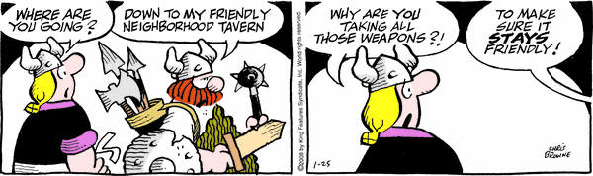
Deterrence
  Rationality at the Core
  Gradations of Rationality: Opportunistic, Feigned, Irrational

Slide 12
Supplementary slides follow; not in text of presentation

Slide 13
“…And if you gaze long into an Abyss, the Abyss also gazes into you.”
Nietzsche
(Beyond Good & Evil)

Slide 14
Evolution of Arsenal
TIME – HEADS – VECTOR PROJECTION
H
E
A
D
S
LV
Delivery Dependent
Low Vulnerable
AV
High Vulnerable
Innovation Dependent
SV
Platform Dependent
Very low vulnerable
T I M E

Slide 15
How Much is Enough? A Logic
Security Benefits of Nuclear Weapons
Deterrent Benefit
H
China
N would be consistent with Doctrine
Security Benefit
N-n
N
N+n
COST
H
Numbers
Diminishing Returns
Vulnerabilities
Survivability
Capability to Conduct Retaliatory Operations

Slide 16
Vulnerabilities and Separation of Custodian from Controller
TIME – HEADS – VECTOR PROJECTION
VA
VNCA
1
VIT&E
CONTROLLER
Vulnerability
VVec
VPers
CUSTODIAN
VTpt
0
1
Deterrence Value
Vulnerability values based on CARVER/DELPHI
Source: Author

Slide 17
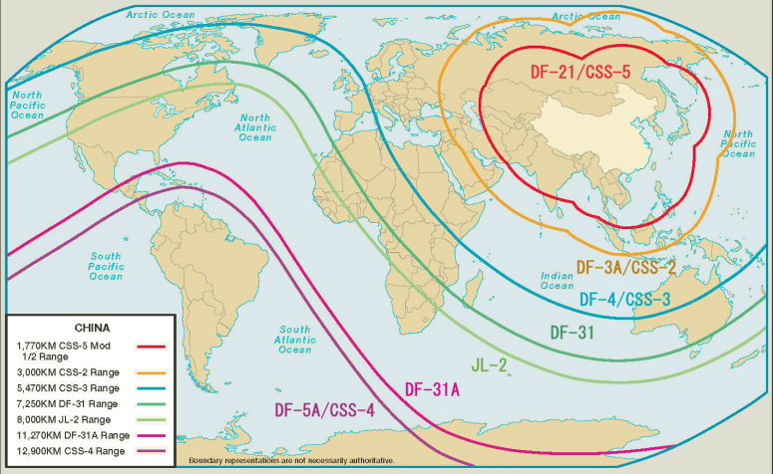
China’s Medium and Intercontinental Ballistic Missile Strike Ranges

Slide 18
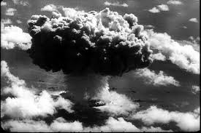

The Curious Strangelove Tale https://www.youtube.com/watch?v=1gXY3kuDvSU

Slide 19
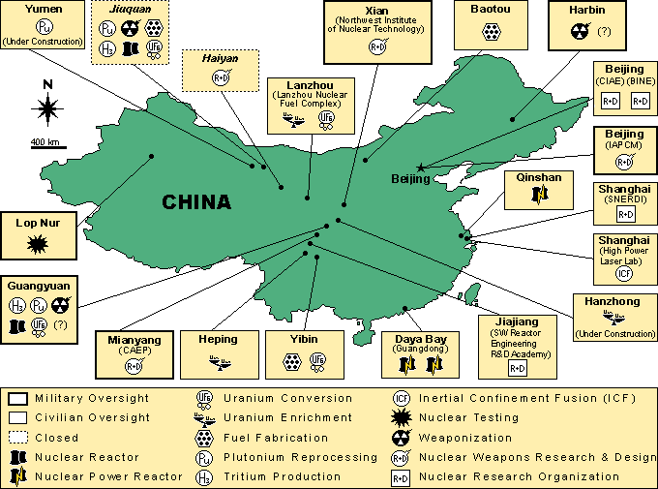
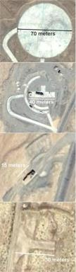
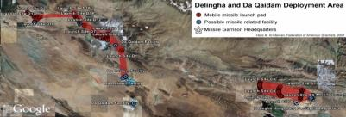
CHINA NUCLEAR FACILITIES
More than 50 launch pads for nuclear ballistic missiles have been identified scattered across a 2,000 square kilometer (772 square miles) area of central China, according to analysis of satellite images.
Launch Pad designs range between 15 and 70 meters.

Slide 20
Pakistan: Prognosis
Deterrent Stability held to ransom by Opacity and Policy of Deliberate Irrationality
The Disarming Strike
Potential for more Frequent Crises
Technology Intrusion Solid fuel Arsenal S/M launched N-LACM
Second Strike Orientation
Role of Jihadis; Brittleness of TNW & C2
The Collusion – Weaken bonds

Slide 21
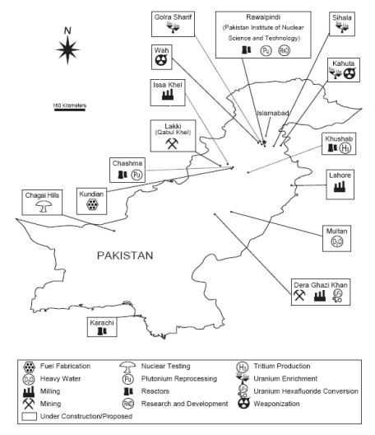
PAKISTAN’S NUCLEAR RELATED FACILITIES

Slide 22
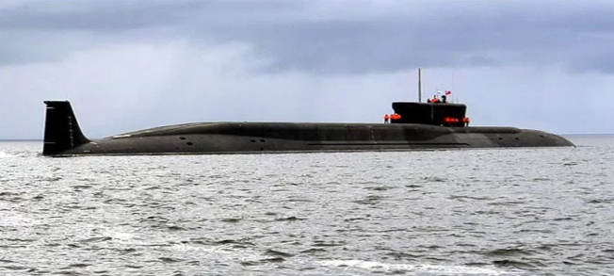
ARIHANT class SSBN
Displacement: 6,000 t L:111m B:15m D:11m
Power: 85 MW
Propulsion: PWR 40% HEU
Sp : > 24 knots Range: unlimited Depth: >350 m
Sensors :USHUS sonar C2 suite: Panchendrya Mission Suite
Armament SLBM: 12 × K-15 or4 × K-4

